Slide 1

Portrait of Baruch Spinoza attributed to Samuel van Hoogstraten

Slide 2

Engraving of Baruch Spinoza

Slide 3

Outline of Spinoza's “Ethics” in Latin

Slide 4
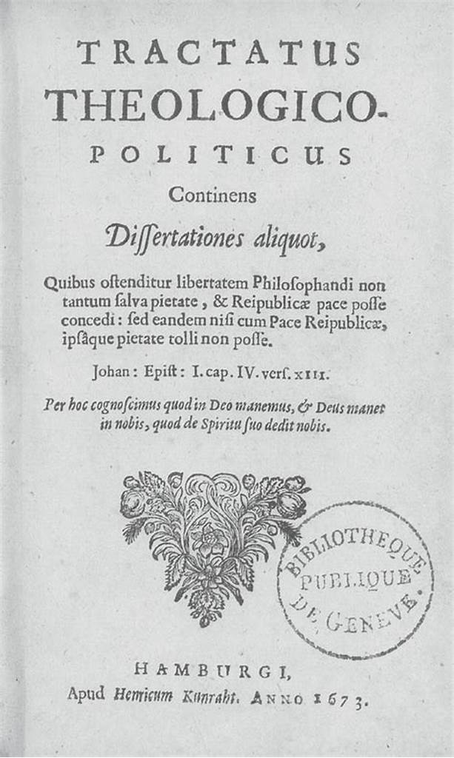
Spinoza, “Tractatus Theologico-Politicus”, 1675

Slide 5

Satoshi Nakamoto statue by Gergely, R., & Gilly, T. (2021). Graphisoft Park, Budapest, Hungary

Slide 6


Painting depicting Spinoza's exclusion from the Amsterdam Jewish community
Seal used by Baruch Spinoza

Slide 7



Nicolaus Copernicus
Galileo Galilei
Johannes Kepler

Slide 8

Gottfried Wilhelm Leibniz
Immanuel Kant
Arthur Schopenhauer
Friedrich Nietzsche

Slide 9

Denis Diderot
Voltaire
Jean-Jacques Rousseau

Slide 10

Voltaire

Slide 11

Galileo Galilei

Slide 12

Spinoza, “The Ethics”

Slide 13

Spinoza, “Tractatus Theologico-Politicus”

Slide 14

Gilles Deleuze

Slide 15

Spinoza, “Tractatus Theologico-Politicus”

Slide 16

“Ethics”, Part I, “Concerning God”

Slide 17

Painting by William Blake, “God creating the Universe”

Slide 18

The earthquake in Lisbon, 1755

Slide 19

Gottfried Wilhelm Leibniz

Slide 20

Jean-Jacques Rousseau

Slide 21


Nicolas Copernic
Charles Darwin

Slide 22

Northern Circumpolar Map, 19th century

Slide 23



Galileo Galilei
Isaac Newton
Albert Einstein

Slide 24

René Descartes

Slide 25

René Descartes, “Discourse on the Method”

Slide 26

Descartes statue

Slide 27

I think, therefore I am
Descartes

Slide 28

Appendix to the first part of Spinoza's “Ethics”

Slide 29

Emmanuel Kant

Slide 30


Ayn Rand
The Fountainhead
Atlas Shrugged

Slide 31

Spinoza, “Ethics”, Part Three

Slide 32
Nicolaus Copernicus
Galileo Galilei
Johannes Kepler

Slide 33

Jean-Baptiste Lamarck

Slide 34

Georges Cuvier

Slide 35

F.A.Hayek, “The Road to Serfdom”

Slide 36
Outline of Spinoza's Ethics in Latin

Slide 37
Painting by William Blake, “God creating the Universe”

Slide 38

Gilles Deleuze

Slide 39


Voltaire, “Letters from England”

Slide 40

Anicet Charles Gabriel Lemonnier, “Madame Geoffrin' Salon”, 18th century

Slide 41

Preface to Spinoza's “Theological-Political Treatise”

Slide 42

Portrait of Socrates

Slide 43

Fresco of St. Augustine by Sandro Botticelli, 1480

Slide 44

Spinoza, “Ethics”, Part 3

Slide 45
Gilles Deleuze

Slide 46
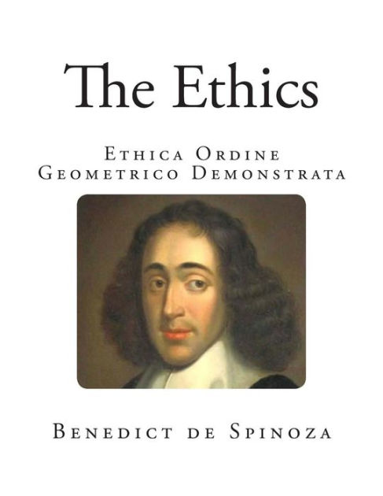
Spinoza, “The Ethics”

Slide 47

Preface to Spinoza's Theological-Political Treatise

Slide 48

Bitcoin growth

Slide 49

Statue of Jupiter

Slide 50
Outline of Spinoza's Ethics in Latin

Slide 51


Friedrich Nietzsche
A statue of Rousseau in Genève

Slide 52

Friedrich von Hayek

Slide 53

Frédéric Bastiat

Slide 54

Milton Friedman

Slide 55

“The Crypto Anarchist Manifesto” and “A Cypherpunk Manifesto”

Slide 56

Bitcoin Genesis Block

